Slide 1

Accessibility

Slide 2
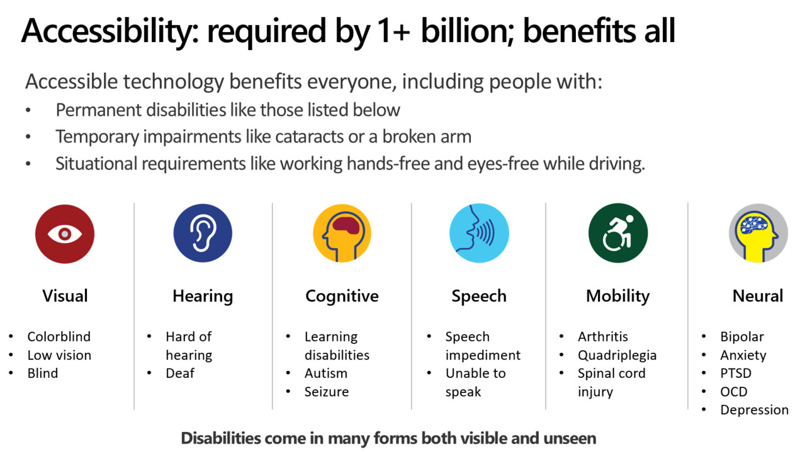

Slide 3

Where does accessibility fit in our projects?
Are we doing images, layouts and text well in our web apps?
Do we think about accessibility when starting a project?
Is it an afterthought, we should do it, but there’s no budget left?
Is it part of every project from the beginning?
Are we making a conscious effort to make content and functionality accessible?

Slide 4
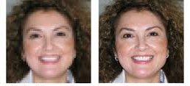

Images
Explain image in alt text. Provide a meaningful description relevant to the purpose in the alt tag. Describe complex images completely in the text.
Good resolution and contrast. Ensure strong contrast for the image elements. Use sharp, clear and good resolution images. (.jpg, .png, .webp)
No text on images. Use normal text instead of images with just text and add styling if needed. If you have to, make sure the alt text is the text on the image.
Complex images need more support. For charts, graphs or infographics, provide same information but in an alternative format.

Slide 5
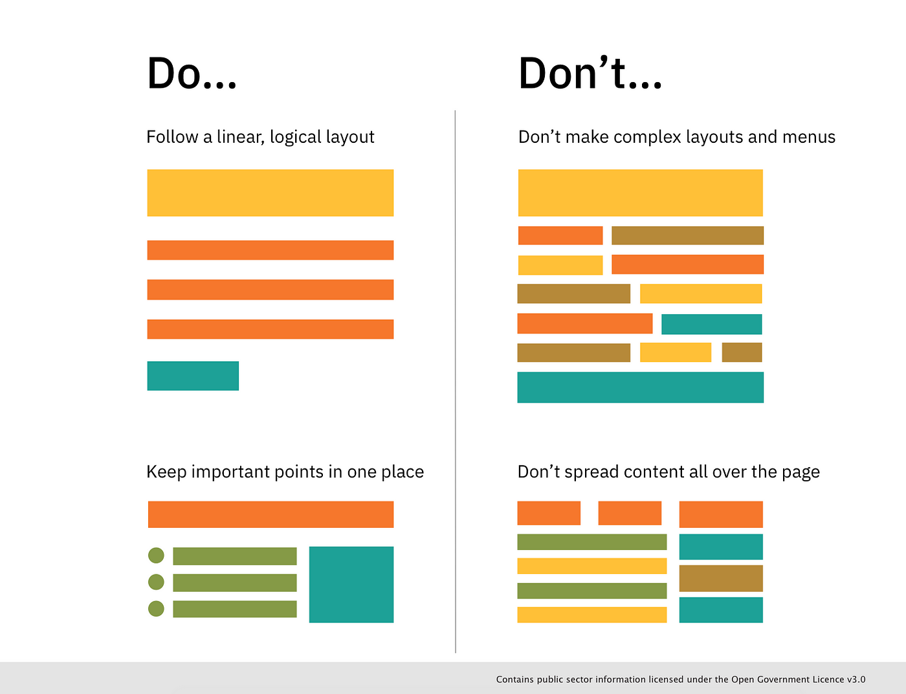
Layout
Structure Content <h1>, <h2>, <nav>, <label>
Follow a linear, logical layout Use section headings and meaningful titles per topic so it is easy to navigate to correct sections and understand the structure.
Build simple and consistent layouts
Use simple sentences and bullets
Use white space Easy for users with dyslexia, visual processing, low vision users

Slide 6
Links
Descriptive and unique. Each link is unique and descriptive. Do not use “Click here” or ”download”.
We publish our amazing newsletter monthly. Click here.
We publish our amazing newsletter monthly.
Page title instead of URL as link text. Use the name of the page/site in a link text rather than the URL. Use plain and concise language for your link text.
You can subscribe to our newsletter. https://docs.google.com/forms/d/e/1FAipQLSeYUEWNdkewewokdfhowDKFJEWO323SkdlsFK?usp=sf_link
You can subscribe to our newsletter.

Slide 7
Links
Links should look like links. Content links should be styled to look different to text. Make sure to use proper color contrast and underlining on hyperlink text.
You can subscribe to our newsletter. (link is there, but you can’t mouseover on tablets or mobile)
You can subscribe to our newsletter.
You can subscribe to our newsletter.
You can subscribe to our newsletter.
You can subscribe to our newsletter.

Slide 8
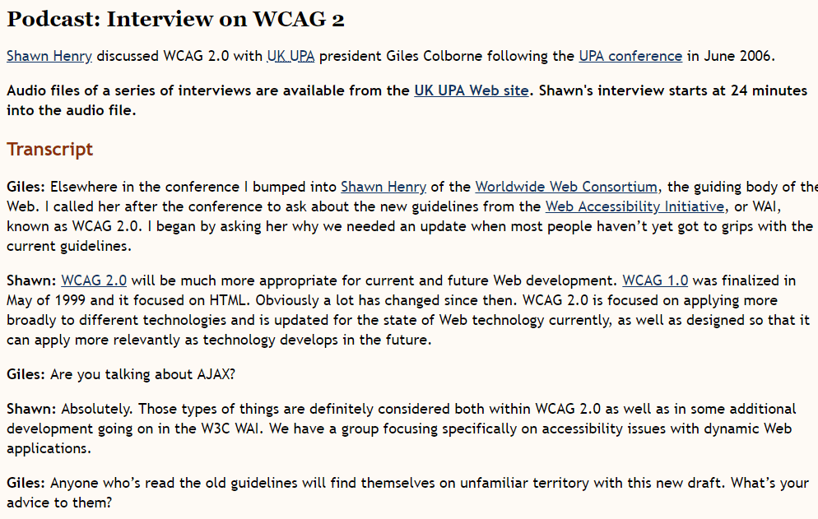
Media
Closed captions for audio and video. Provide synchronized captions, text versions of the spoken words and sounds presented in audio and video
80% of people use closed captions in loud or quiet environments.
Provide transcripts as well. Provide transcripts of audio recordings and videos. Transcripts aid searching and readability over just using captions.
Avoid autoplay. Ensure the video player enables the user to stop and play the video or audio. Controls should also work with the keyboard only.

Slide 9
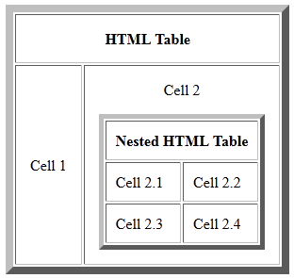
Tables
Create simple tables. Create simple tables, one table per topic and one piece of data per cell. Do not use of nested tables as this complicates navigation by keyboard.
Define headers on columns and rows. Each column and row should have a header, technically and visually as it creates a more structured table.
Use tables only for data not layout (FRAMES.gov, looking at you). Use tables only to organize tabular data, keep them as simple as possible. Avoid using images of tables instead of proper tables.
Alternating row colors are helpful.

Slide 10
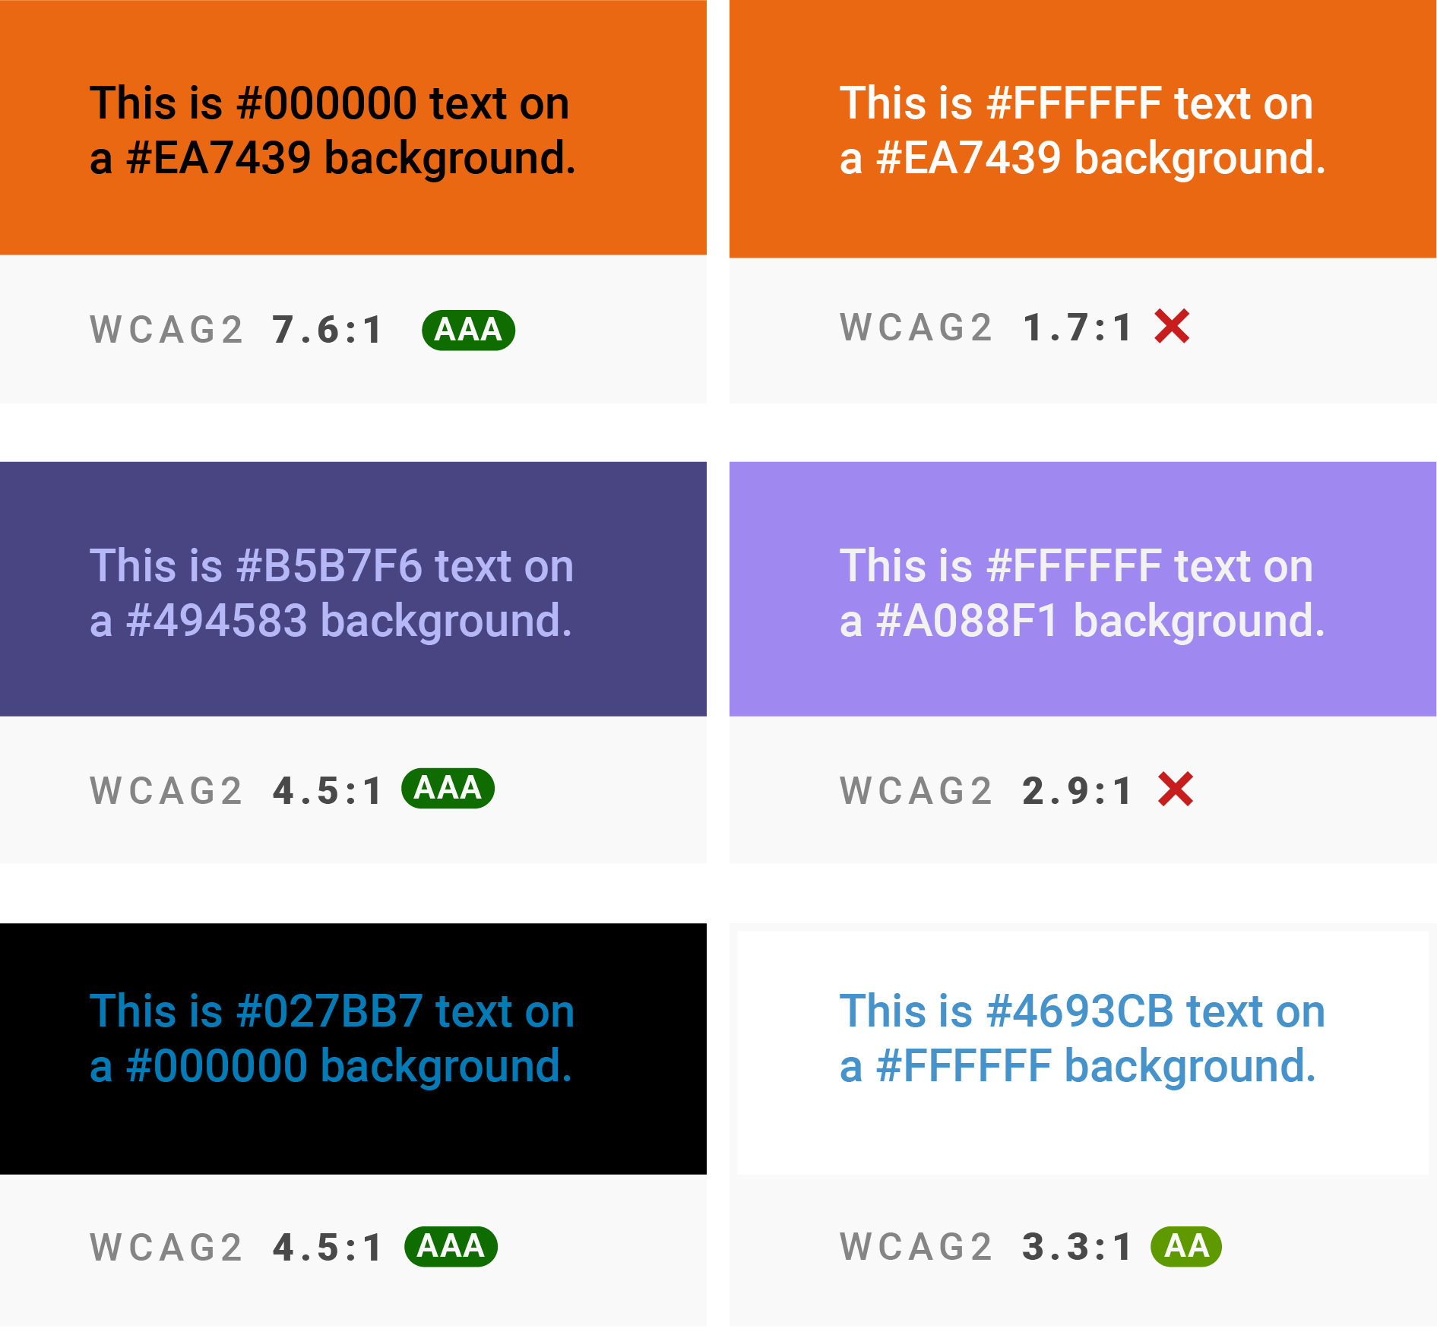
Text
Plain language. Use plain, concise language. Be consistent throughout with language, terminology and page structure.
Minimize uppercase usage. Ensure uppercase usage is minimalized as this makes text harder to read. Only use where appropriate (Acronyms, logos).
Color contrast. Ensure strong enough contrast between text and the background and be careful of light shades like gray and yellow.

Slide 11
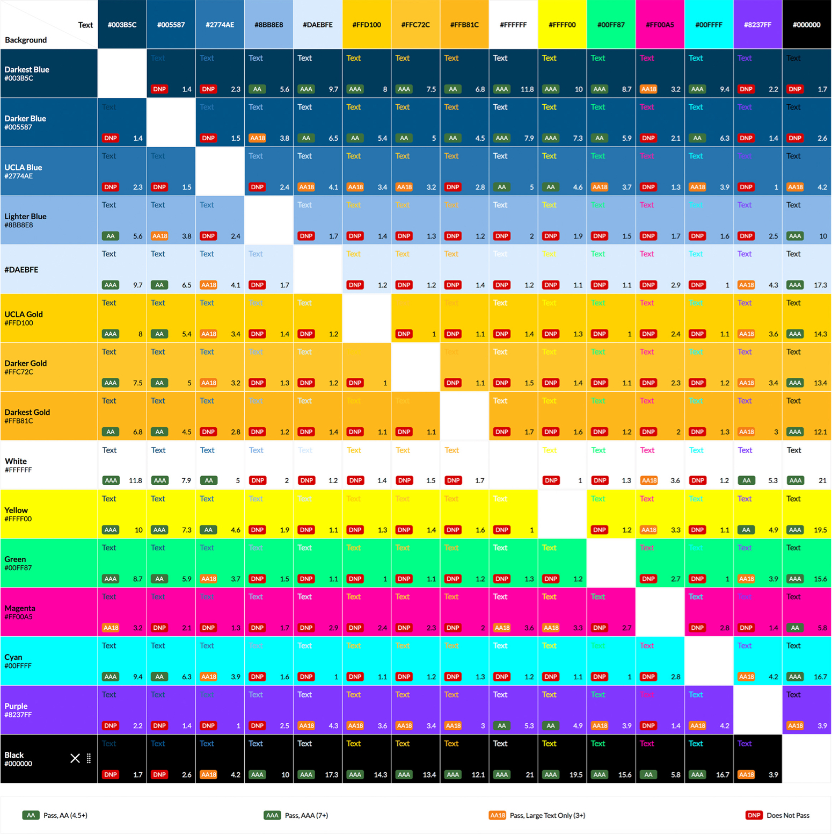
Color
WCAG Standards: The Web Content Accessibility Guidelines set minimum contrast requirements:
AA level: 4.5:1 for normal text, 3:1 for large text
AAA level: 7:1 for normal text, 4.5:1 for large text
Ratio is calculated by comparing the relative luminance of the lighter color to the darker color.
Pure white has the highest luminance value, while pure black has the lowest, giving them the maximum possible contrast ratio of 21:1.

Slide 12
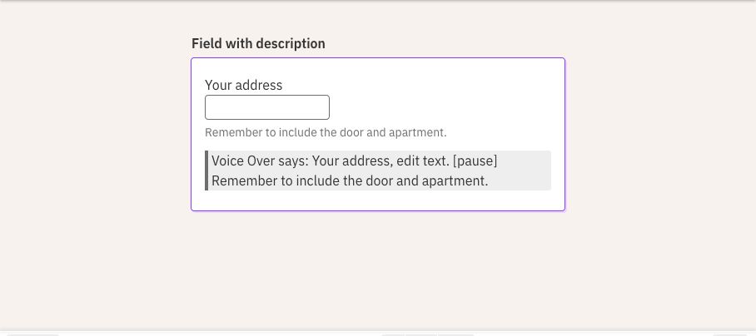
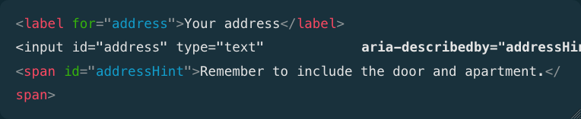
Forms
Form navigated only using keyboard. For people who cannot use a mouse, they can still fill and submit a form. Setting compliant focus indicator on each field.
Context Each form field must have an accessible name label. Screen readers can read a field name to its user

Slide 13
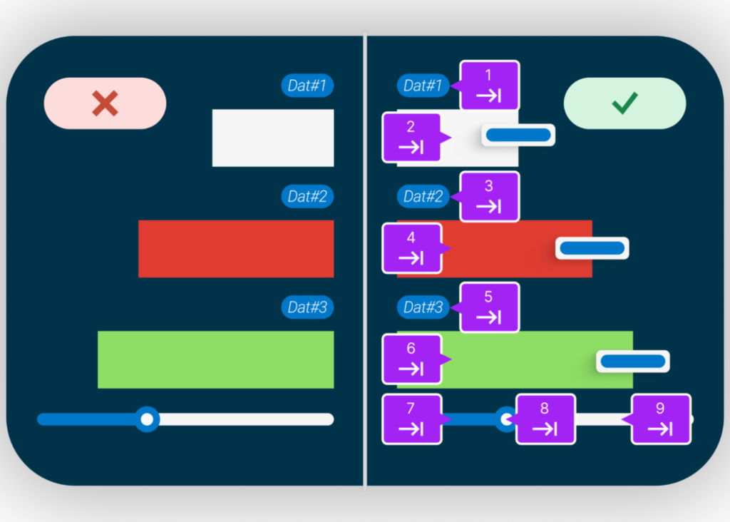
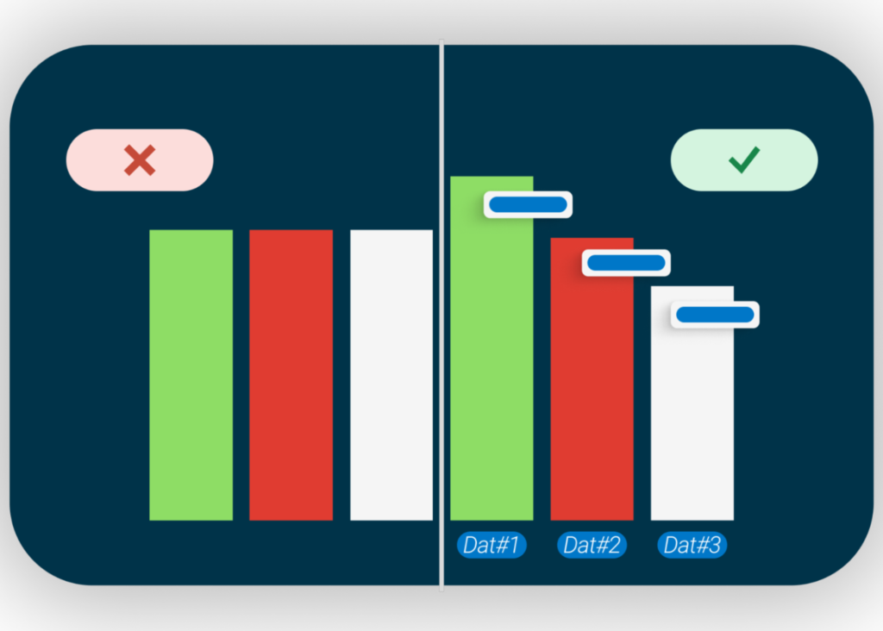
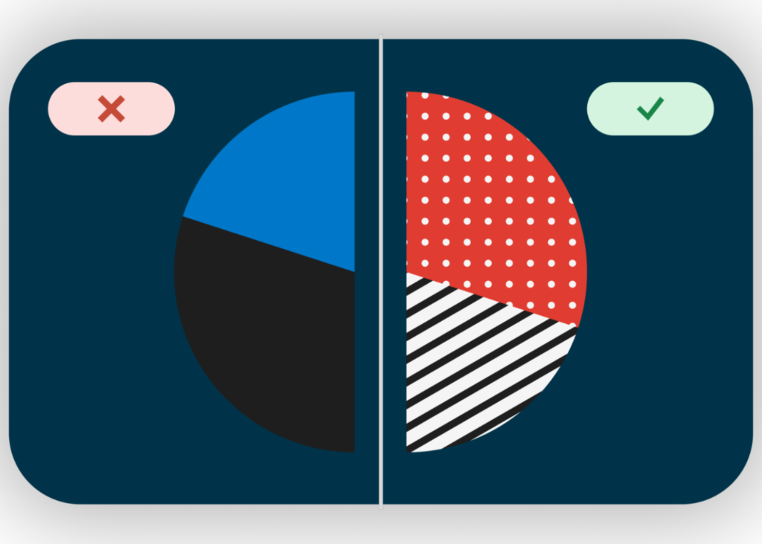
Interactivity
Choose chart libraries with built in accessibility features
Ensure seamless keyboard navigation of interactive elements
Use colors along with data labels
Color contrast (WCAG requires 4.5:1 AA)

Slide 14
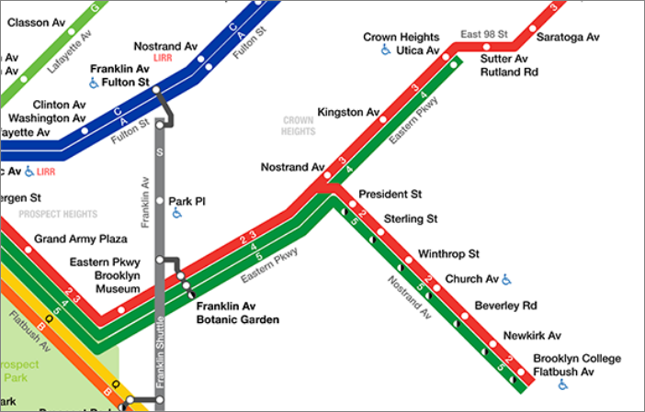
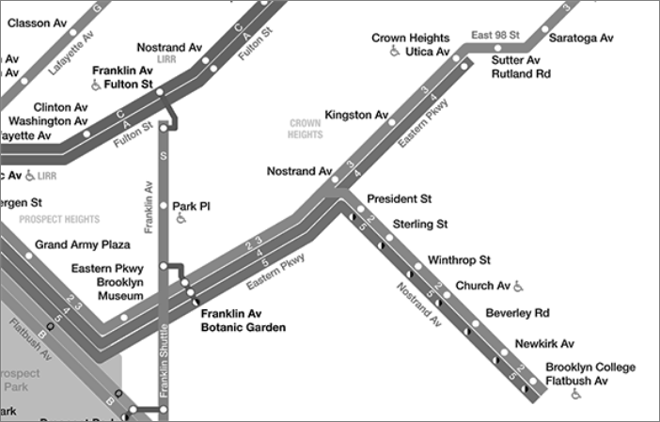
Maps

Slide 15
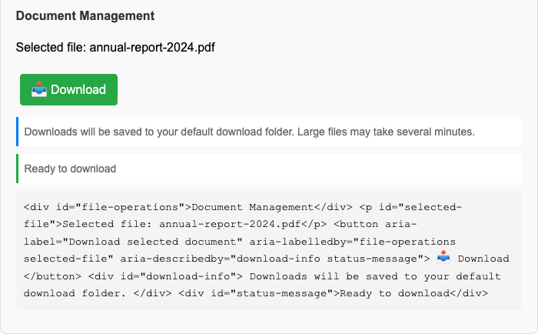
ARIA (Accessible Rich Internet Applications) Labels
Screen reader compatibility and enhances experience for diverse abilities – provides a “voice” for elements that would otherwise be silent
Aria-label: provides an accessible name for an element
Aria-labelledby: Reference an element that provides a label for the current element
Aria-describedby: References an element that provides a longer description for the current element

Slide 16
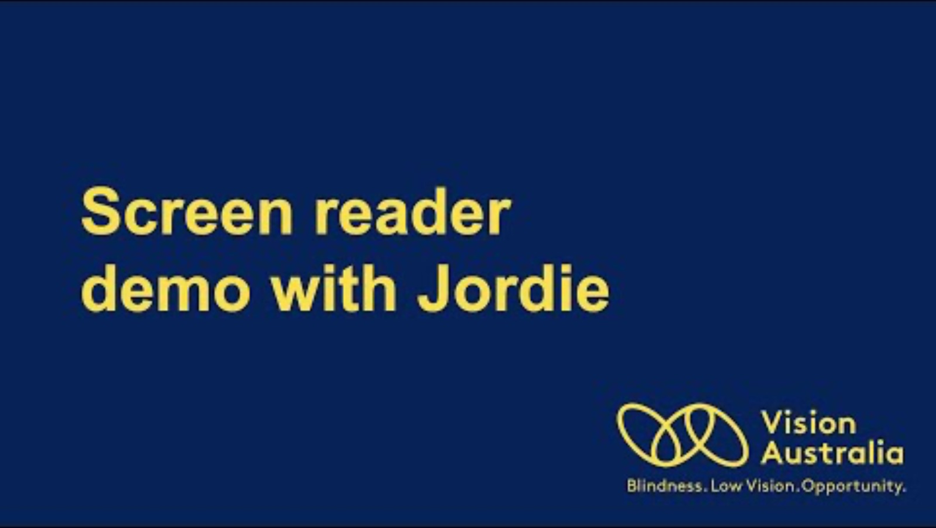
Screen Reader Demo

Slide 17

DOJ Web Accessibility Rule (2023)
Technical standards of Web Content Accessibility Guidelines (WCAG) 2.1 Level AA, which requires 50 success criteria to make websites accessible.
Converting pictures and documents so they can be read with assistive technology for individuals with vision loss and providing captions for live and prerecorded videos for individuals with hearing loss Proper keyboard navigation Adequate color contrast Alternative text for images Accessible forms and interactive elements
The rule applies to all state and local governments (which includes any agencies or departments of state or local governments, public schools, etc).
Population over 50K – 4/24/2026
Population under 50K – 4/26/2027
Legal obligations under the ADA.

Slide 18
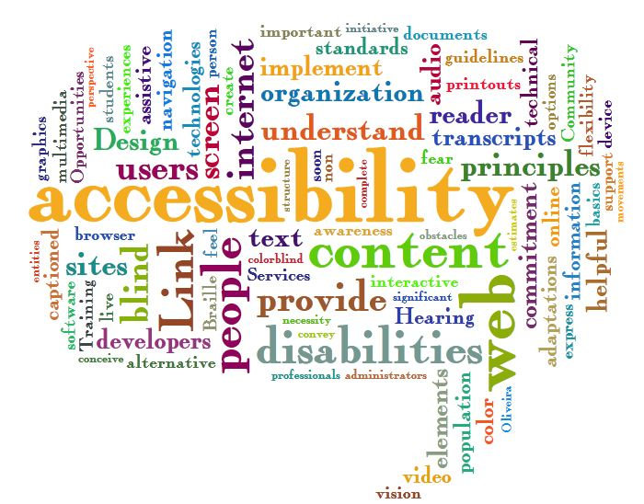
508 Compliance
Federal law requiring federal agencies to make electronic and information technology accessible to people with disabilities.
What’s covered?
Websites/Web Applications
Software Applications
Operating Systems
Telecommunication products
Video and Multimedia products
Self contained, closed products (Kiosks)
Desktop and portable computers, including mobile phones
Agencies must include 508 requirements in contracts, test and validate before deploying
508 is specific to federal agencies and contractors

Slide 19

Does this apply to RCDS?
For university research projects receiving federal funding:
Section 508 does NOT directly apply to the research projects themselves
Section 504 DOES apply to ensure non-discrimination based on disability
Websites on NIH and NSF for accessibility guidance have been taken down.
Digital research deliverables and outputs should be accessible.
Universities increasingly adopt Section 508 standards as best practice due to multiple overlapping legal requirements
RECOMMENDED: While maybe not legally required under Section 508 for research projects, universities should follow Section 508/WCAG 2.1 AA standards for any digital content or tools developed with federal research funding to ensure compliance with Section 504 and avoid potential legal issues.

Slide 20
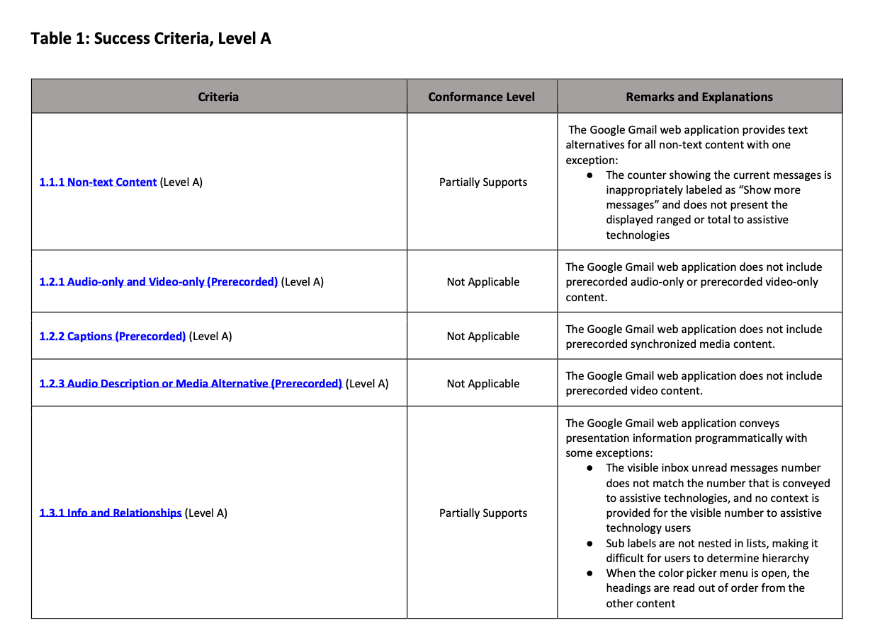
VPAT / ACR
Voluntary Product Accessibility Template or Accessibility Conformance Reports
Standardized documents that detail how well a website conforms to accessibility standards, particularly Section 508 and WCAG guidelines.
Systematically goes through each accessibility criterion and indicates whether the product "Supports," "Partially Supports," "Does Not Support," or is "Not Applicable" to each requirement, along with explanatory remarks.
NOTE: Websites should have ACRs/VPATs available upon request. This applies to universities, research institutions, and contractors receiving federal research grants, as they're considered recipients of federal funding and must ensure their digital content is accessible to people with disabilities.

Slide 21
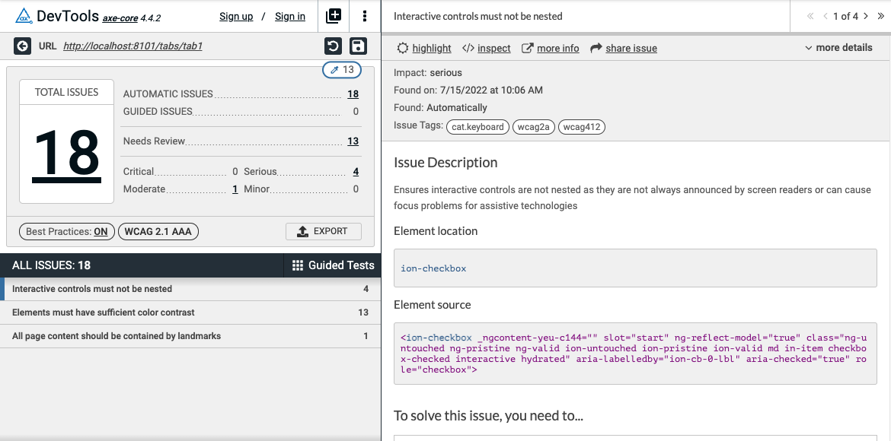
Tools
Axe
WAVE
Lighthouse
Siteimprove
Flask app?

Slide 22

AI and Accessibility
Equally AI
AccessiBe
Axe Assistant
Tenon.io
Build your own?

Slide 23


Slide 24

Resources
Website Accessibility Checklist based on WCAG 2.2 AA
Deque
Deque University
Accessibility Fundamentals (Microsoft Learn)
W3C
WebAim
WCAG
MDN Web Docs – Accessibility
Home Office UK Digital, Data and Technology Posters
ARIA

